Slide 1


Collections & efficiency

Slide 2
Topics / plan
Measuring efficiency
Classic algorithms
Impact of implementation
Hashing
Selecting a suitable algorithm and/or collection

Slide 3
Efficiency of algorithms
Comparison
Memory requirements
Execution time
absolute
relative (”time complexity”, ”growth rate”)
Ex
Linear search, Binary Search
worst, best, average
Big-O notation

Slide 4
public static Comparable linearSearch (Comparable[] list,
Comparable target)
{
int index = 0;
boolean found = false;
while (!found && index < list.length)
{
if (list[index].equals(target))
found = true;
else
index++;
}
if (found)
return list[index];
else
return null;
}

Slide 5
public static Comparable binarySearch (Comparable[] list,
Comparable target)
{
int min=0, max=list.length, mid=0;
boolean found = false;
while (!found && min <= max)
{
mid = (min+max) / 2;
if (list[mid].equals(target))
found = true;
else
if (target.compareTo(list[mid]) < 0)
max = mid-1;
else
min = mid+1;
}
if (found)
return list[mid];
else
return null;
}

Slide 6
Logarithms
How many times can we half N before we only have 1
Log₂ - logarithm function with base 2
The inverse function to the exponential function with base 2:
f(x) = 2^{x}
Log₂
How does it look - graphically?

Slide 7
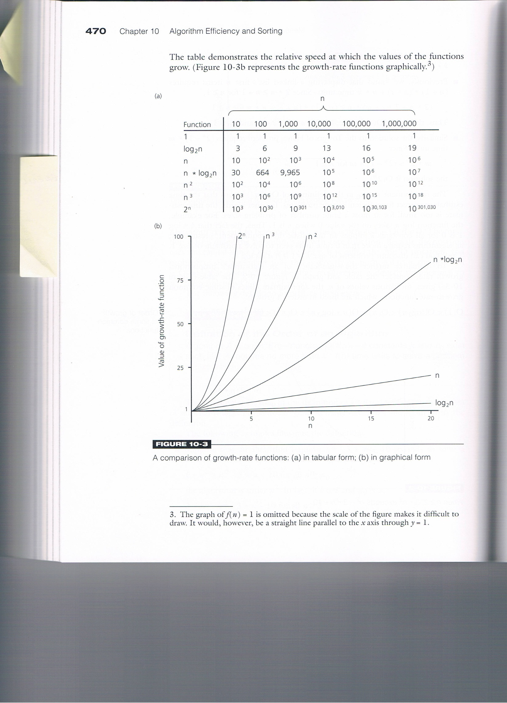

Slide 9
public static void selectionSort (Comparable[] list)
{
int min;
Comparable temp;
for (int index = 0; index < list.length-1; index++)
{
min = index;
for (int scan = index+1; scan < list.length; scan++)
if (list[scan].compareTo(list[min]) < 0)
min = scan;
// Swap the values
temp = list[min];
list[min] = list[index];
list[index] = temp;
}
}

Slide 10
Classic algorithms for manipulating a list
Linear search: O(n)
Binary search: O(log n)
Selection Sort: O(n²) (same for Insertion and Bubble Sort)
Quick Sort: O(n*log n) (average) O(n²) (worst)

Slide 11
Hashing – Why another data structure?
insert search
Unsorted array O (1) O (n)
Unsorted linked list O (1) O (n)
Sorted array O (n) * O (log n)
Sorted linked list O (n) O (n)
Binary search tree O(log n) O (log n)
*) O(log n) + O (n)

Slide 12
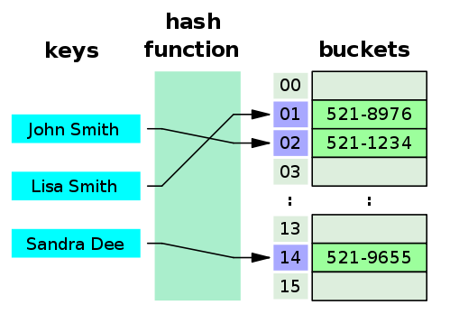
Hash table

Slide 13
Hashing – principle
Data is stored in an array
The index is calculated based on a key.
index = hash-function (key)
Insert
put(key, value)
”Search”
get (key)
The hash-function must
return an integer (index < size of table)
be easy to calculate (why?)
Minimize the number of collisions
distribute data elements evenly across the table (why?)

Slide 14
Hash function (ex):
key value modulo 11
(11 = size of table)
ex:
Key value: 13
hash (13) => 13 mod 11 => 2
0 | 11
1 | 1
2 | 13
3
4
5
6
7
8 | 30
9
10 | 10

Slide 15
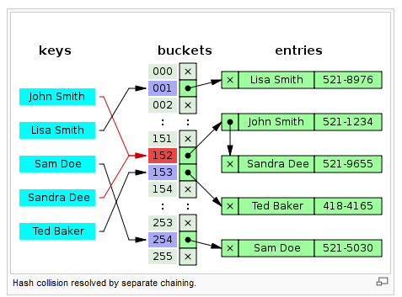
Collisions, chaining

Slide 16
Efficiency and hash table
Insert, delete and search is (nearly) independent of the number of elements (n)
O(1)
Load factor
Table size << number of possible different key values
Preferred when you require fast
search
Insert
but not fast
Iterate sorted
Location of max /min

Slide 17
Choice of data structure (array/linked/hash table)? Criterion: Frequency of operations
 | 1 | 2 | 3 | 4
Insert | rarely | often | often | often
Delete | rarely | often
Search | often |  | often
Iterate unsorted |  | often
Iterate sorted | ofte |  |  | often
Notes:
1: array
2: linked eller hash
3: hash
4. Array eller linked

